Slide 1
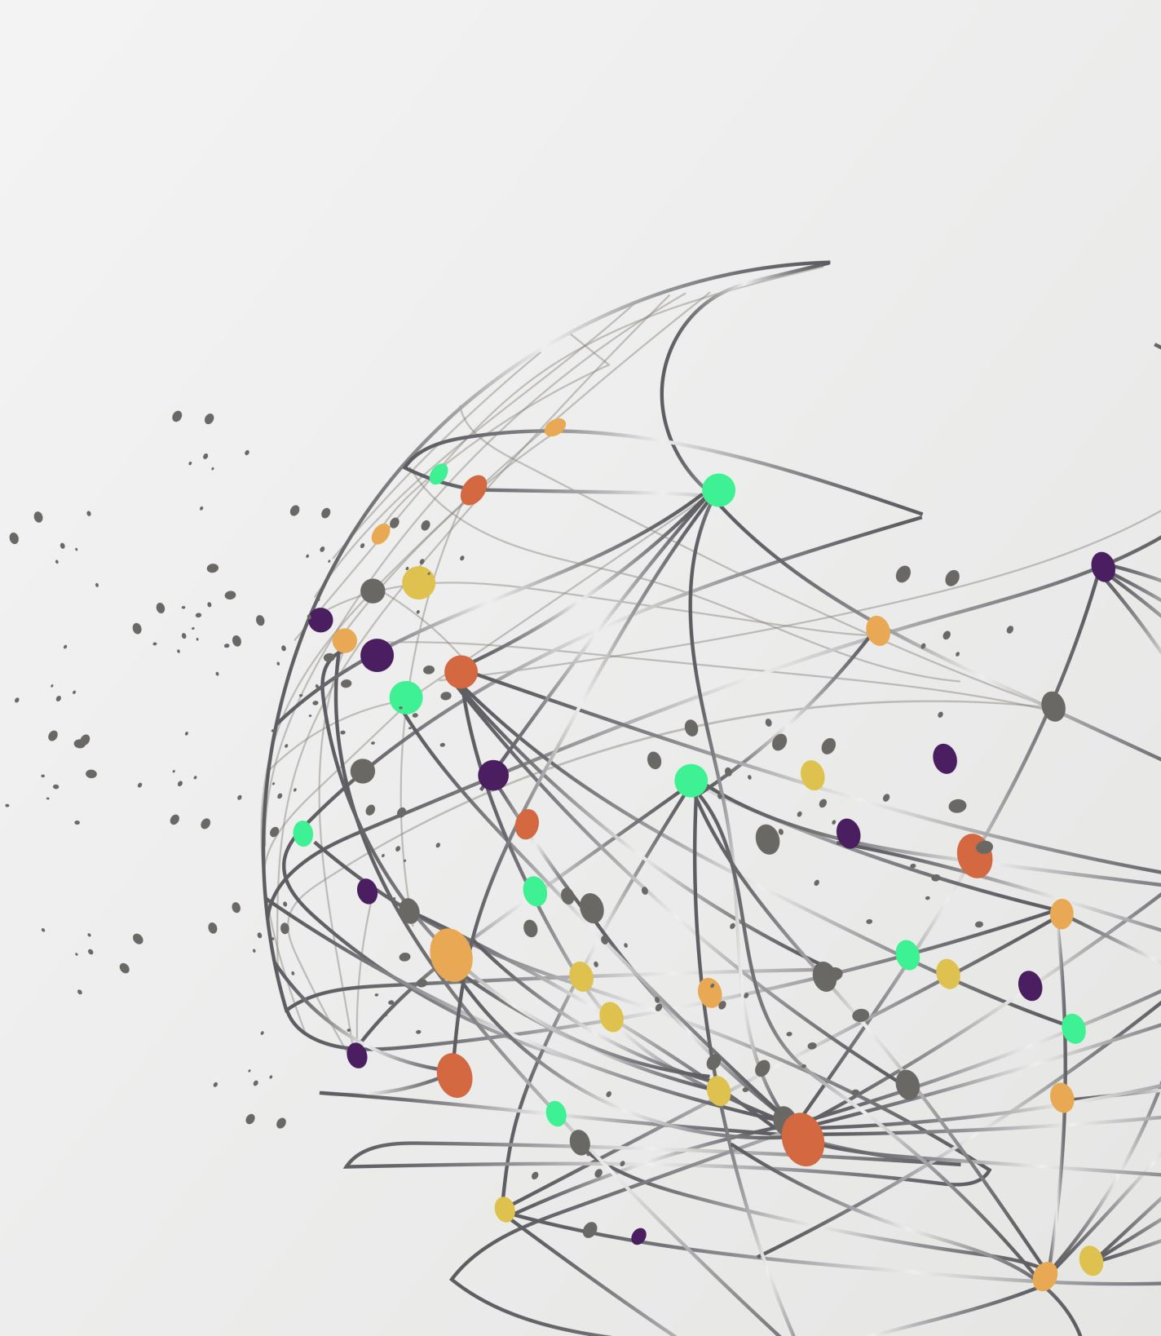
Sub-fly Student Democracy
Group 3:
- Bucsa Alina
-Fenesan Ramona
-Tomescu George
-Balteanu Sorin

Slide 2
1. Social programs
Programs for reintegrating people in need in society
Organizing charity events
Trees planting in areas of need
Sponsorships for sports competition

Slide 3
2. Public figures partnership
Promoting the company through partnerships with public personalities
Trust-worthy image of the company
Influencers on social platforms

Slide 4
3. 4-days working week
Employees can have an extended weekend
Come back to work with new perspective, and more relaxed and focused

Slide 5
4. Monthly non-formal activities
Hierarchy is "dissolved"
Teams enjoy common hobbies
Build relationships

Slide 6
5.Soft skills development. Trainings offered on:
- creative thinking
-Emotional intelligence
- curiosity

Slide 7
6. Bonuses
Offered when actions taken by employees benefit the company
Bringing new employees
Offer trainings to teammates

Slide 8
7. Public appreciation
Exceptional results
Building emotional security
Trust

Slide 9
8. Trainings
Offered to new employees as well
Develop skills outside those needed for work

Slide 10
9. Build relationships at the workplace
Mutually beneficial
Avoid overpromising, under-delivering

Slide 11
10. Respect time and opinions
Learn to deal with disagreements
Show understanding
Good time management

